Slide 1
Capstone Results
June 18

Slide 2
Case 1
In this case, we simulate the dataset and set the variance of each variable (noise and explanatory) to 0.5 to 5.0 in an interval of 0.5 and display the results of each simulation.

Slide 3
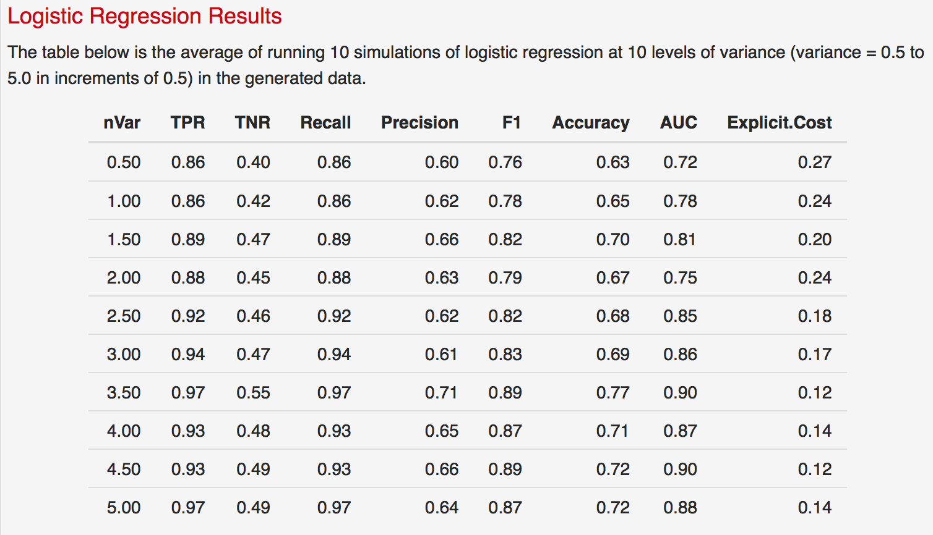
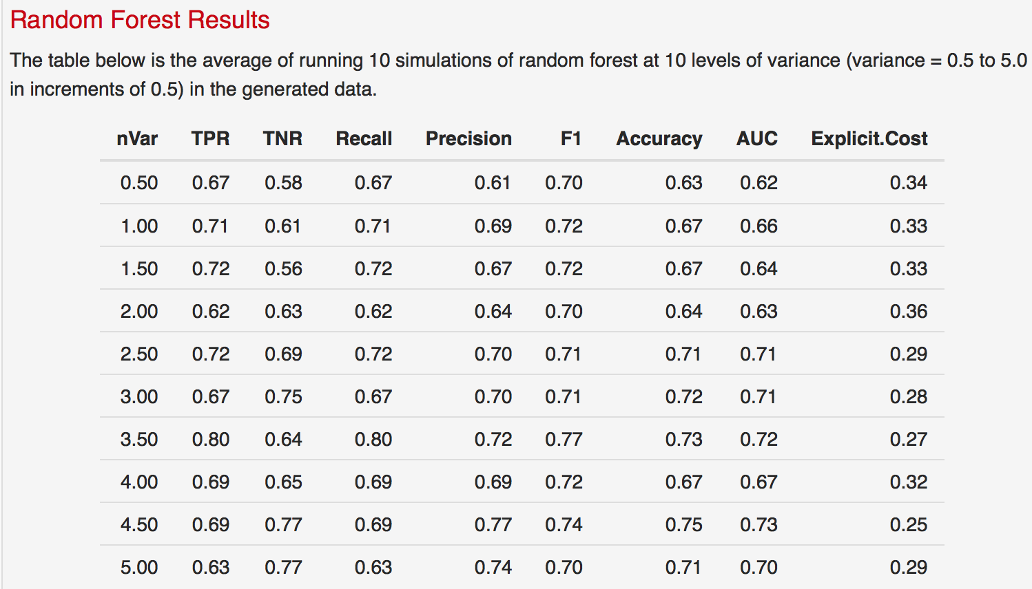
Case 1: 10 Simulations

Slide 4
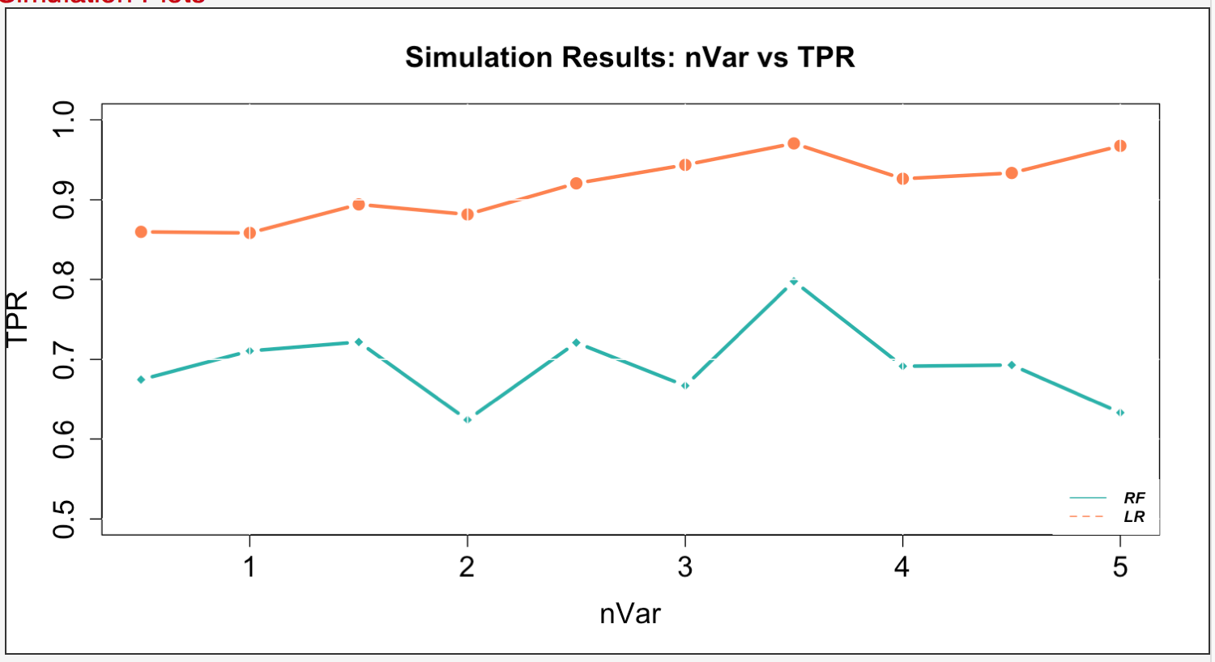
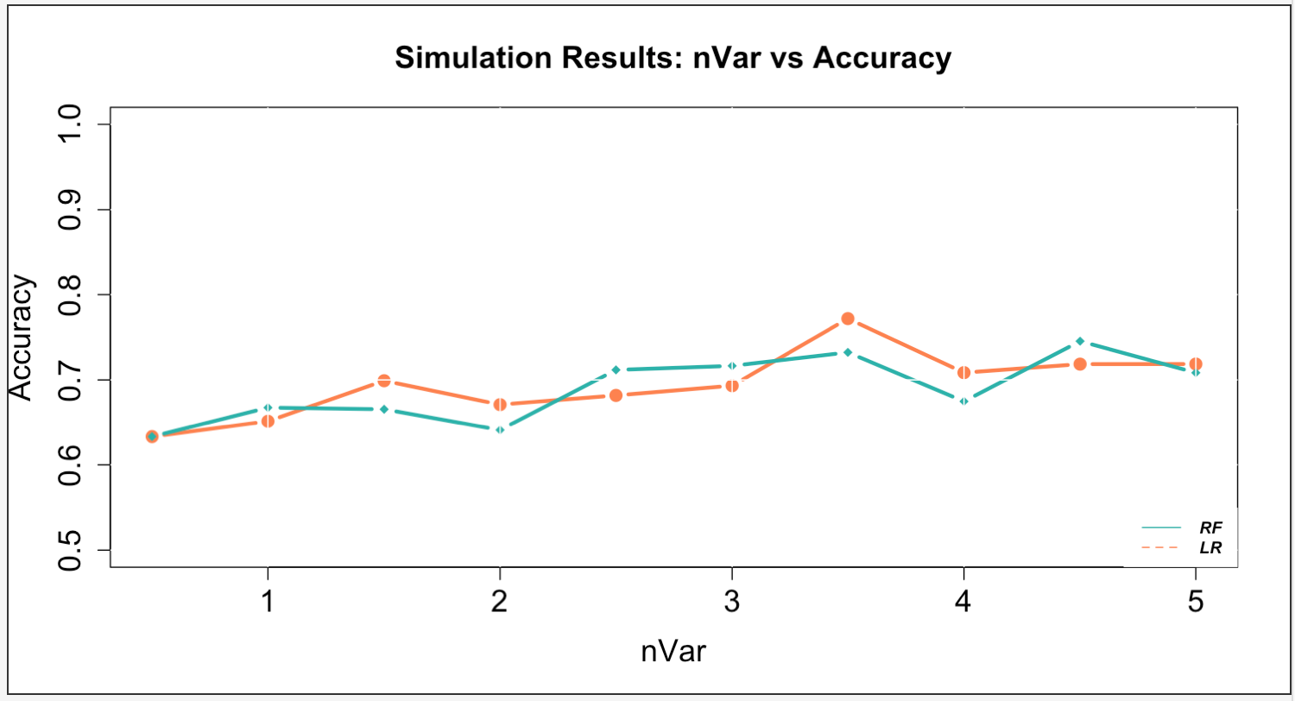
Case 1: 10 Simulations

Slide 5
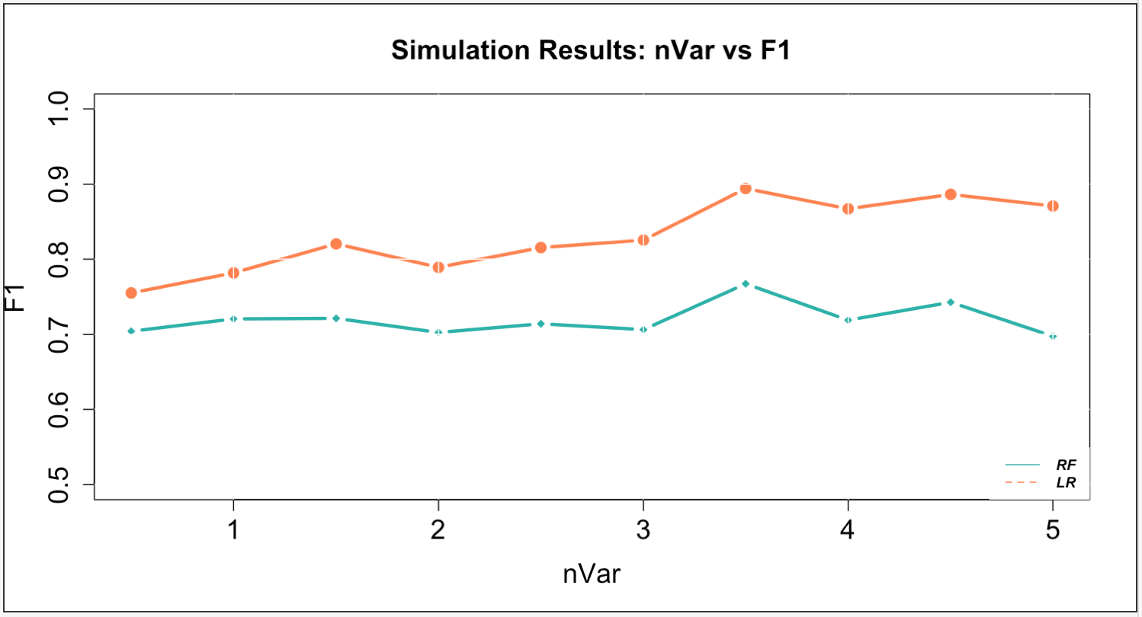
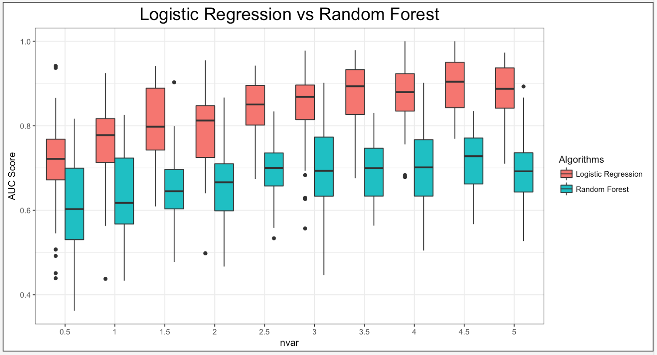
Case 1: 10 Simulations

Slide 6
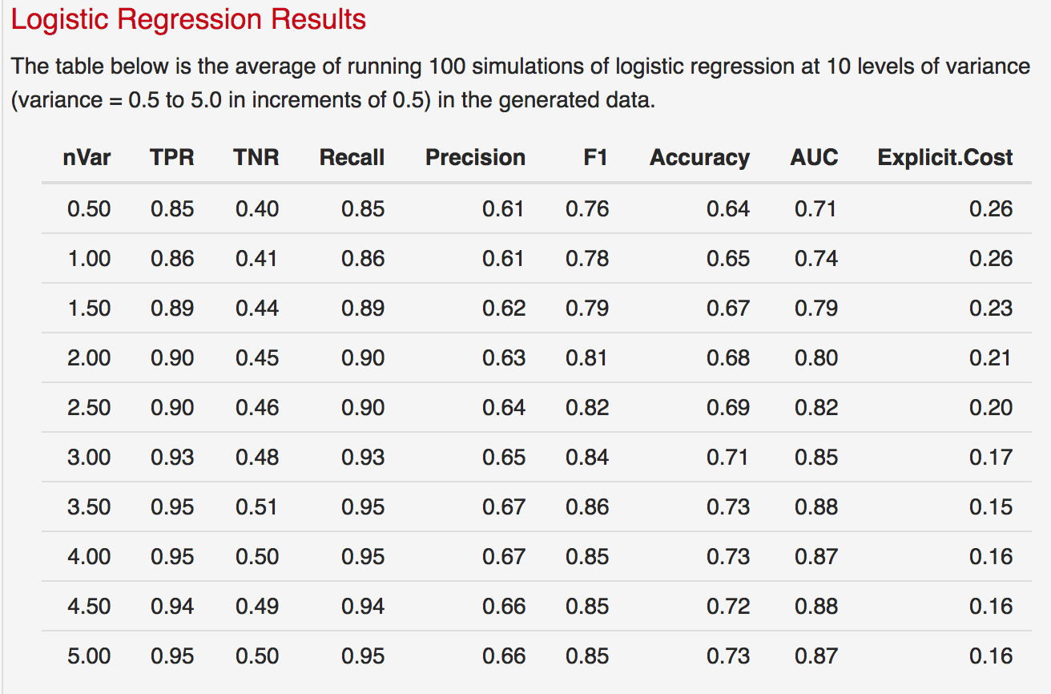
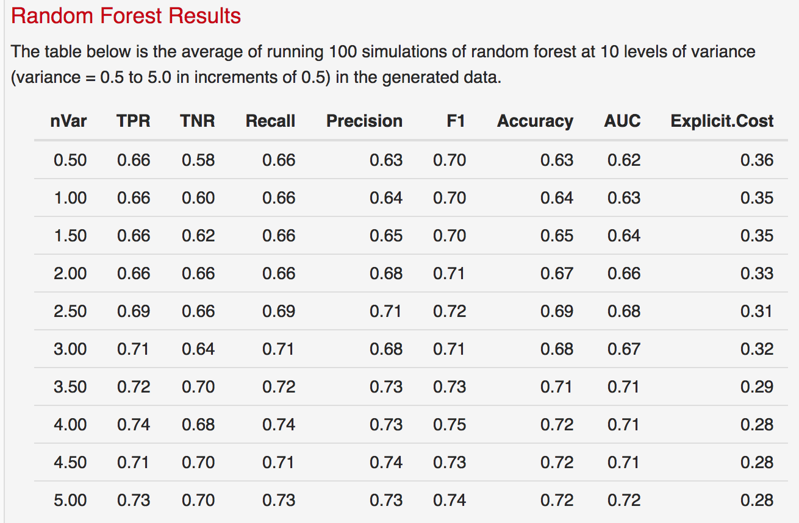
Case 1: 100 Simulations

Slide 7
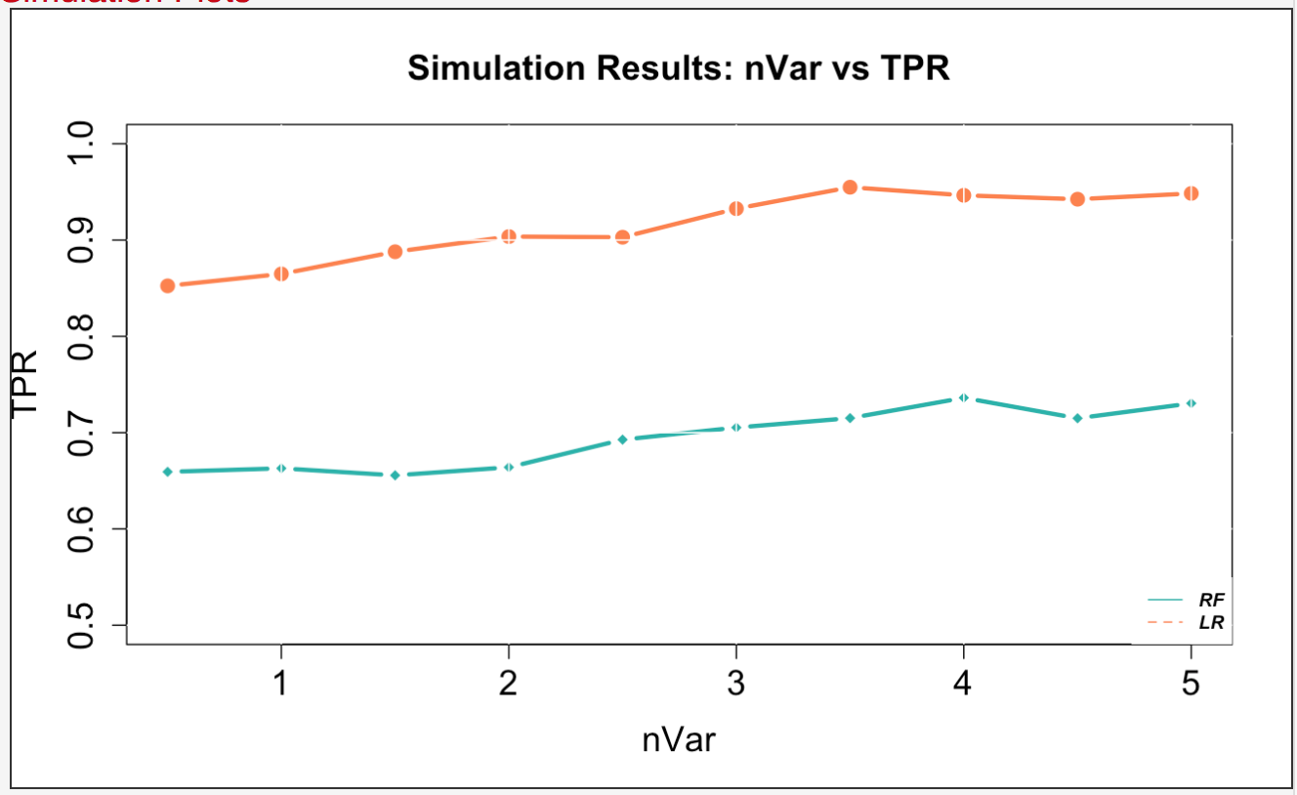
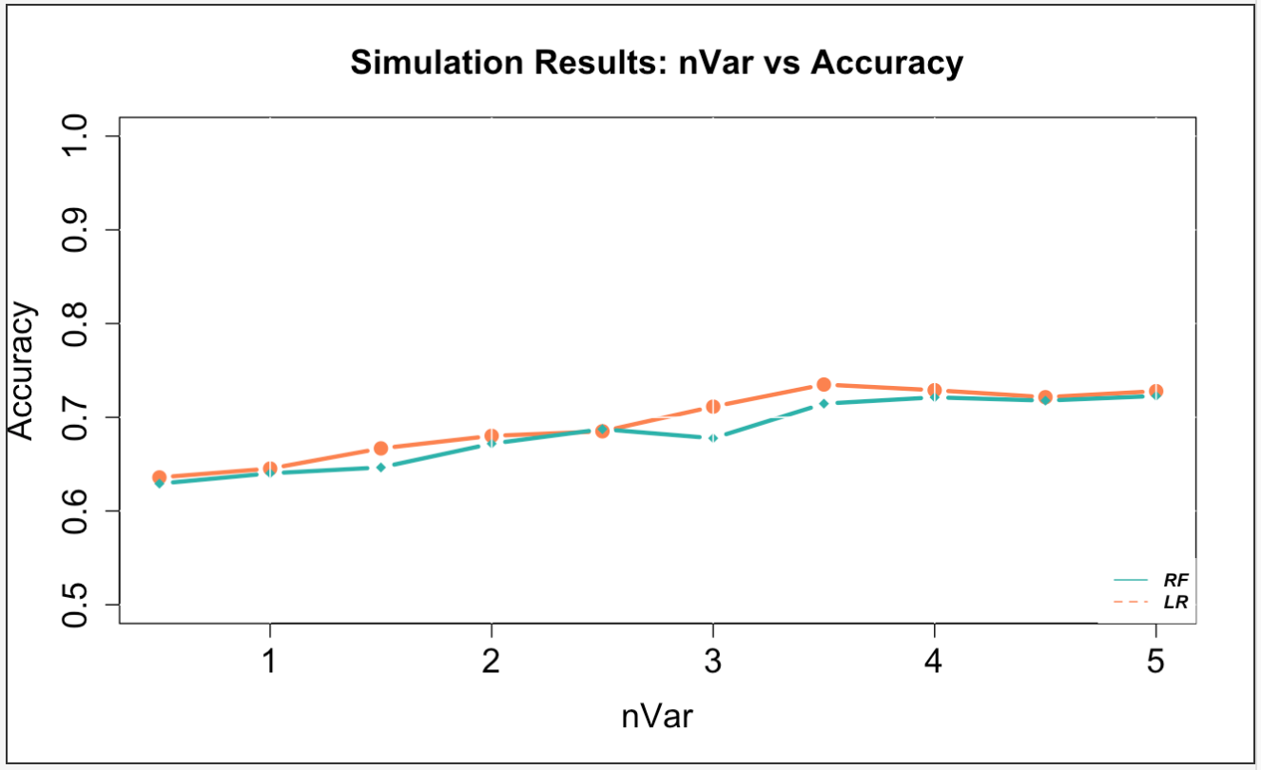
Case 1: 100 Simulations

Slide 8
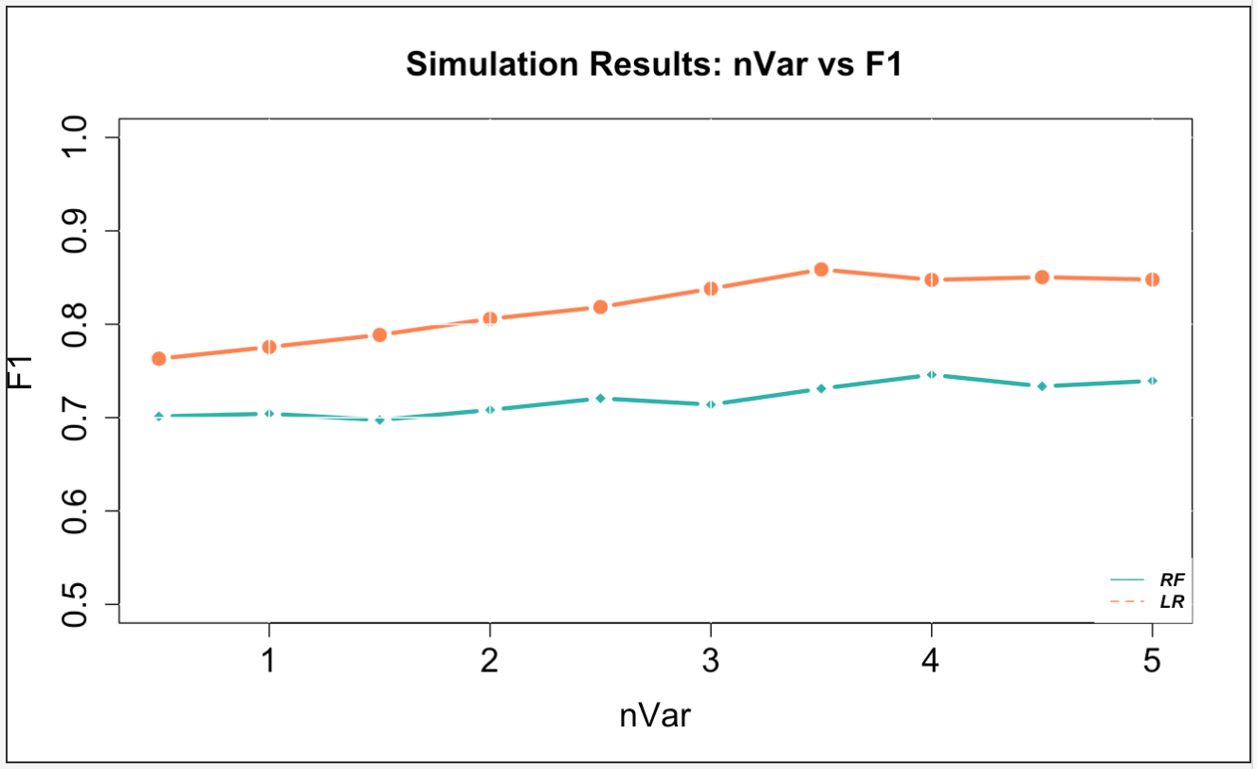
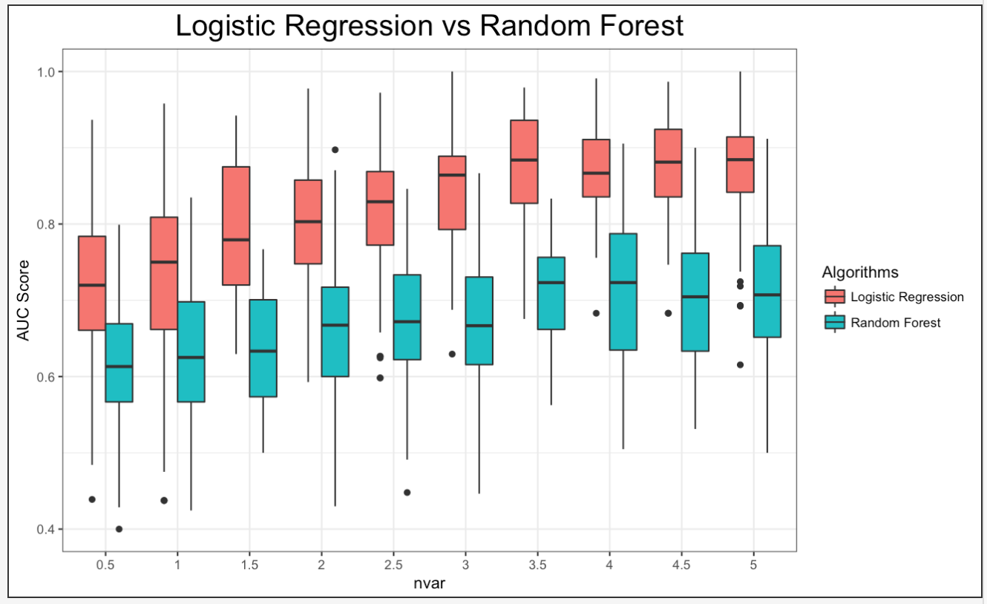
Case 1: 100 Simulations

Slide 9
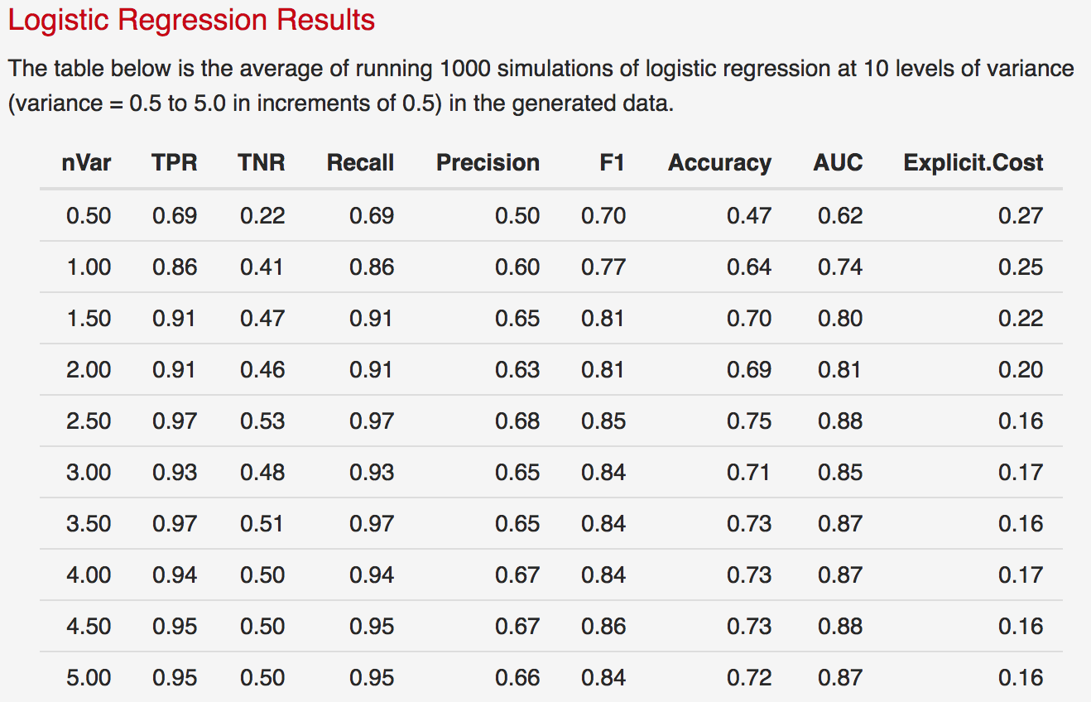
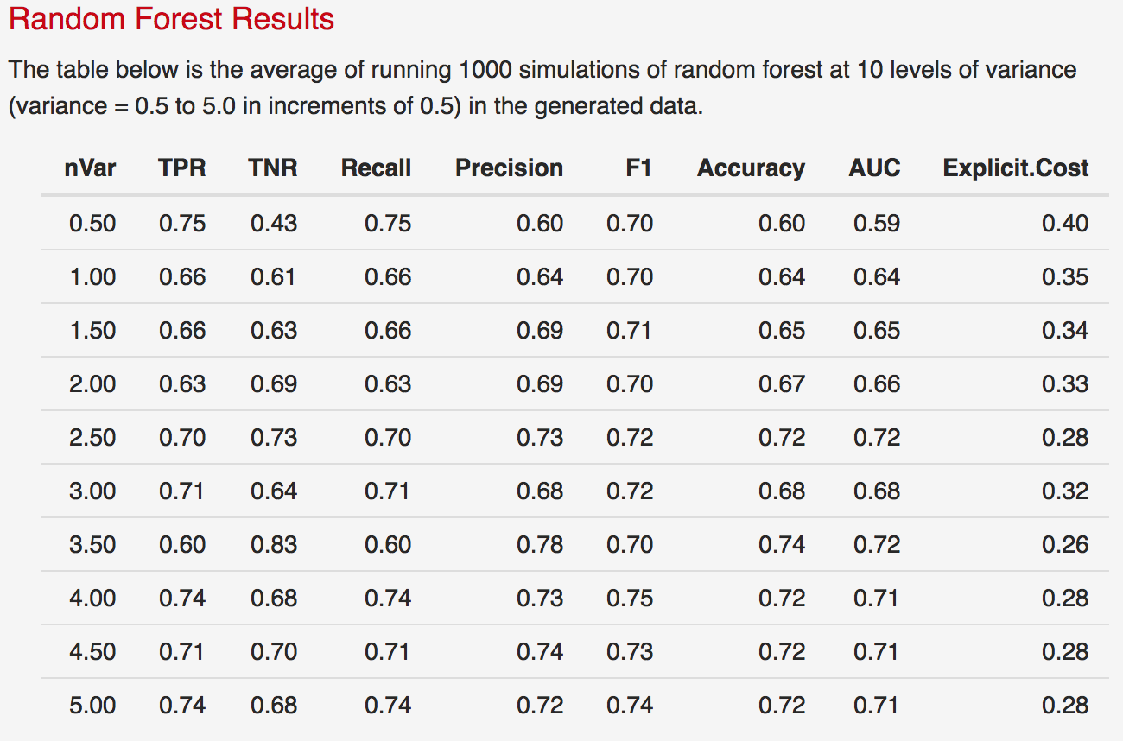
Case 1: 1,000 Simulations

Slide 10
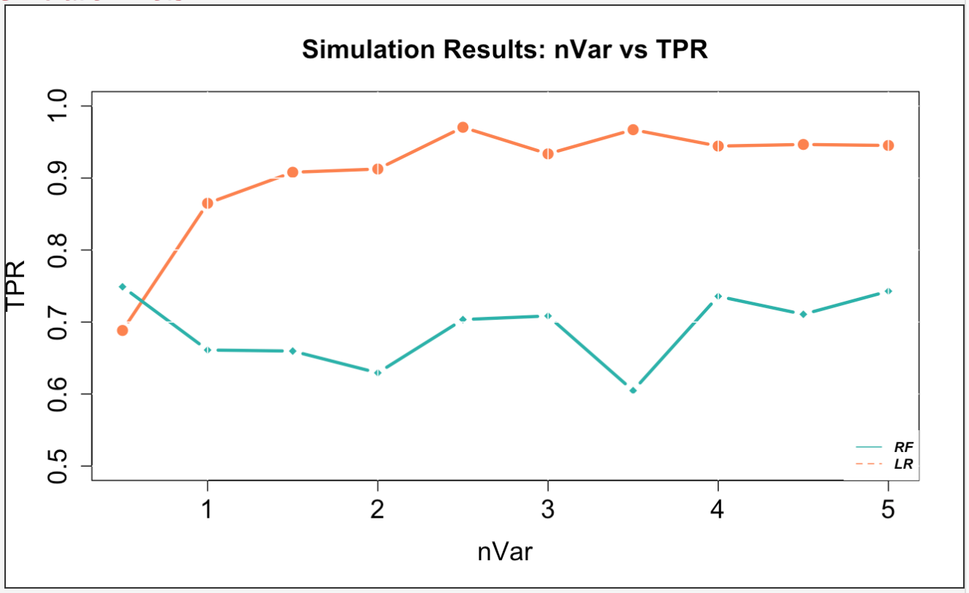
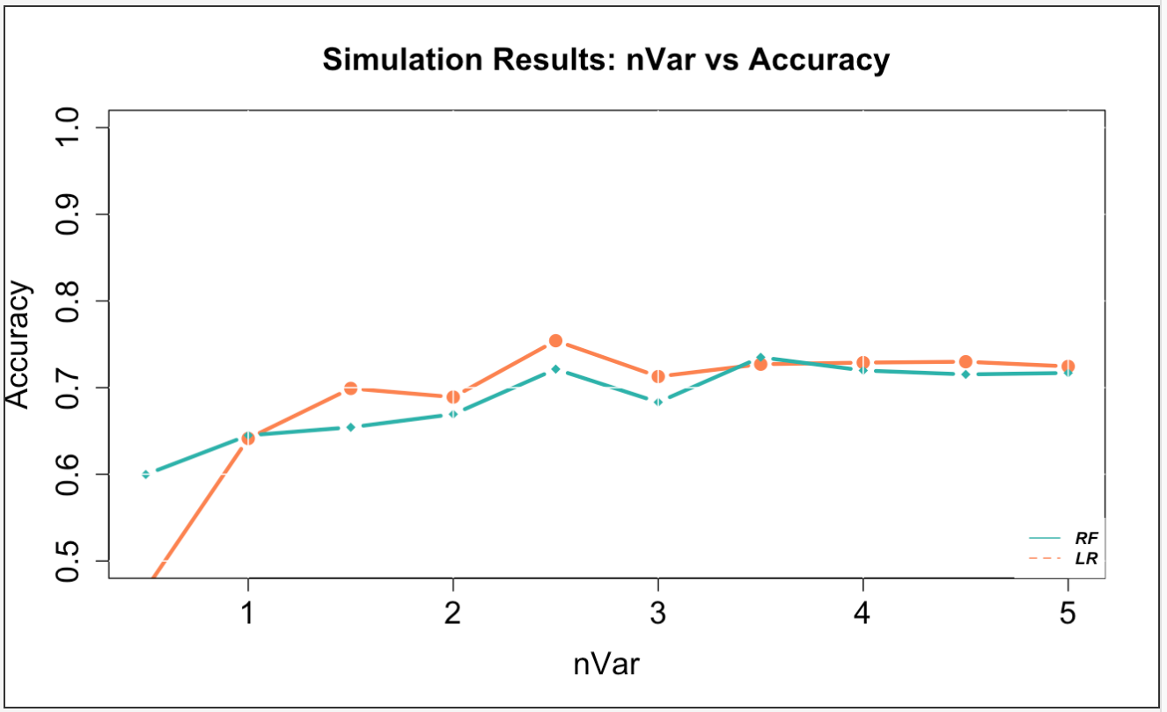
Case 1: 1,000 Simulations

Slide 11
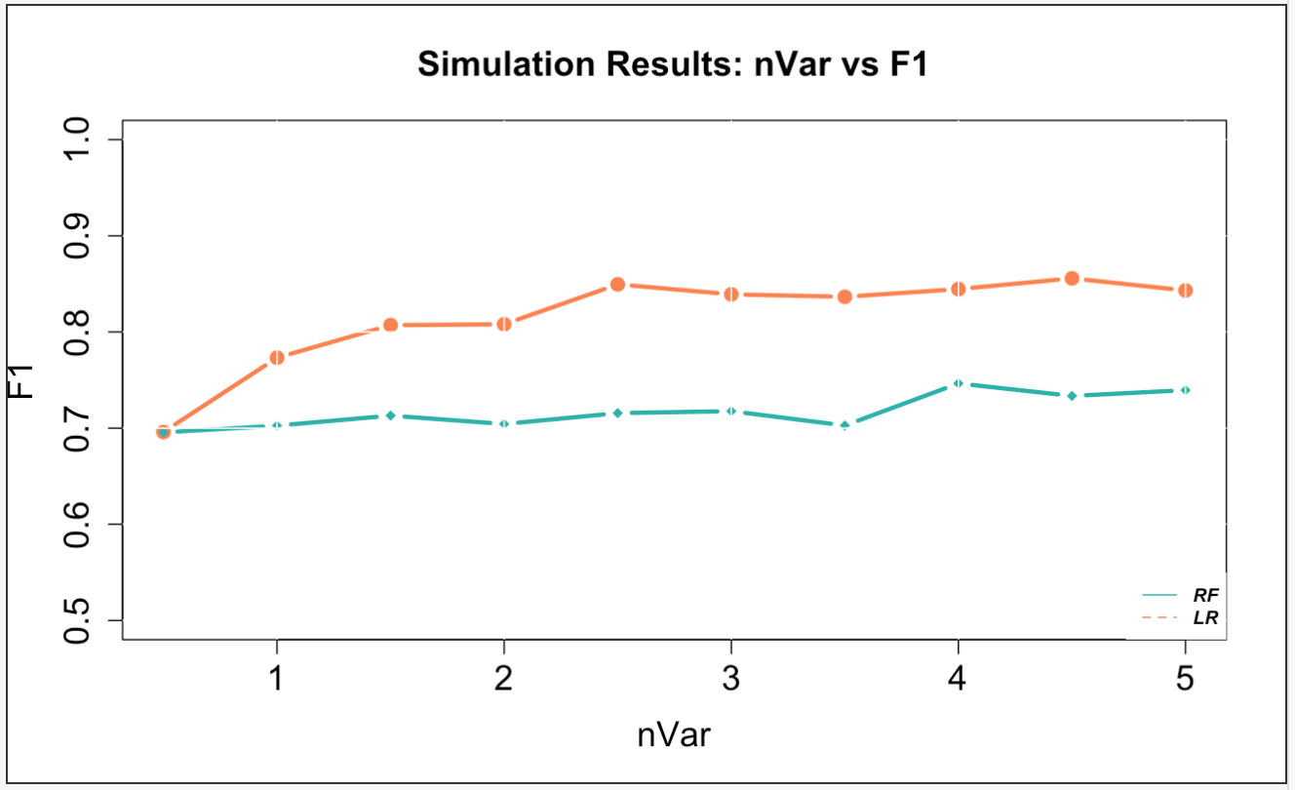
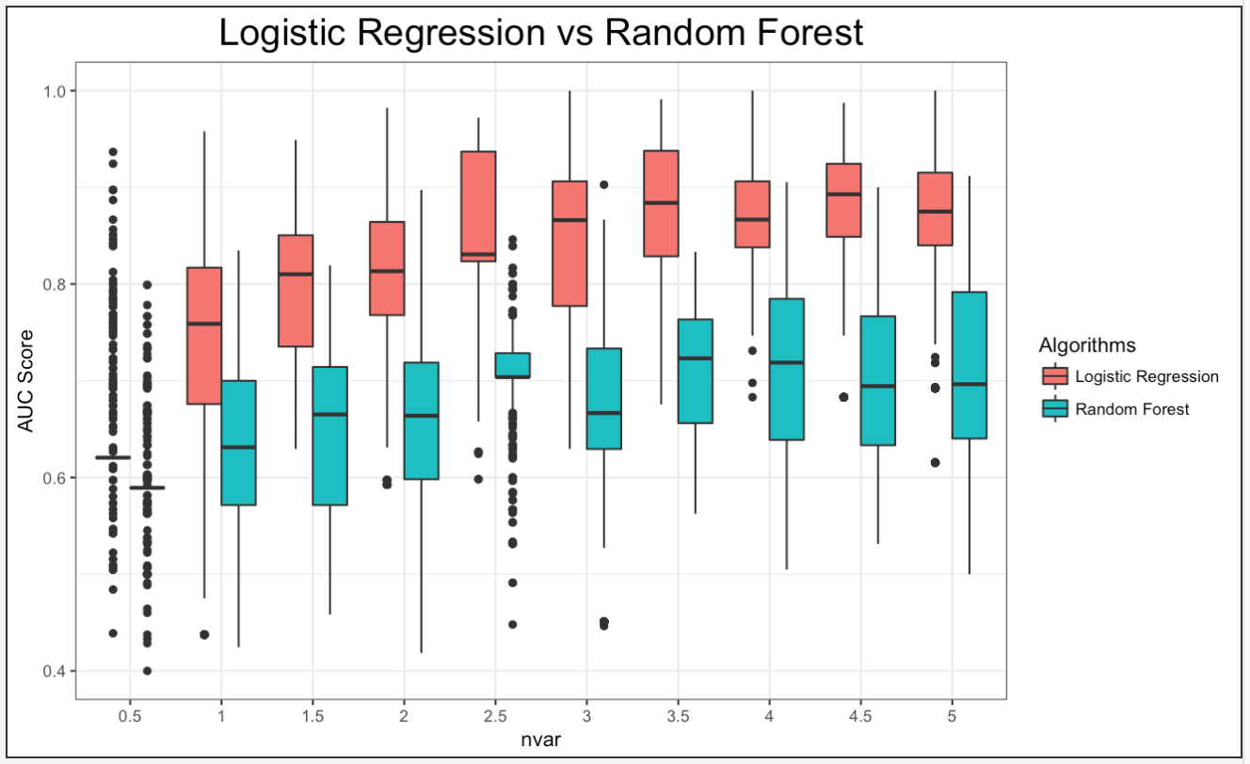
Case 1: 1,000 Simulations

Slide 12
Case 1: 10,000 simulations

Slide 13
Case 1: 100,000 simulations

Slide 14
Case 2
In this case, we simulate the dataset and set the number of noise variables to 1, 5, 10, 20, and 50 and display the results of each simulation.

Slide 15
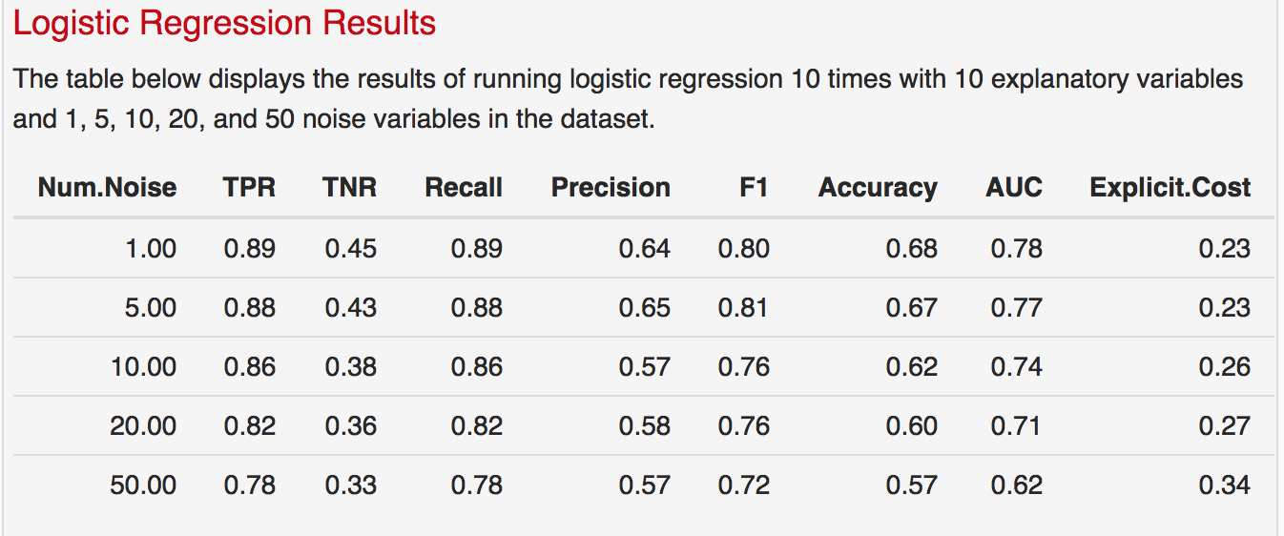
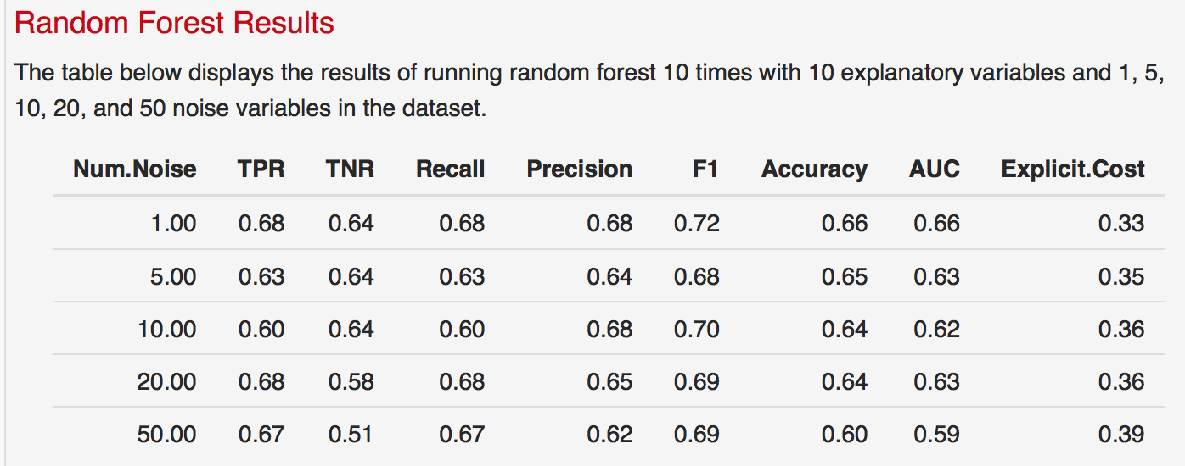
Case 2: 10 Simulations

Slide 16
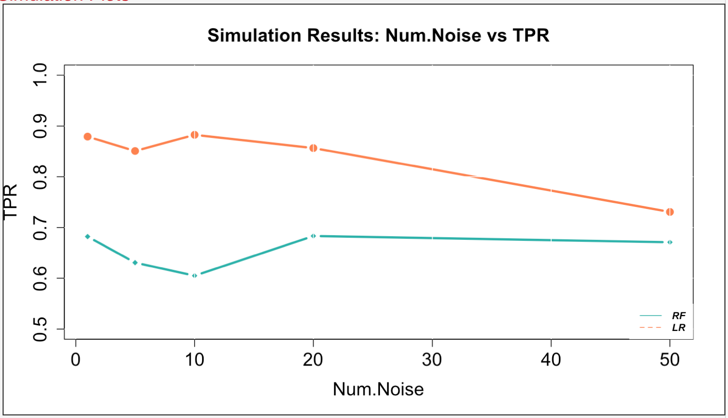
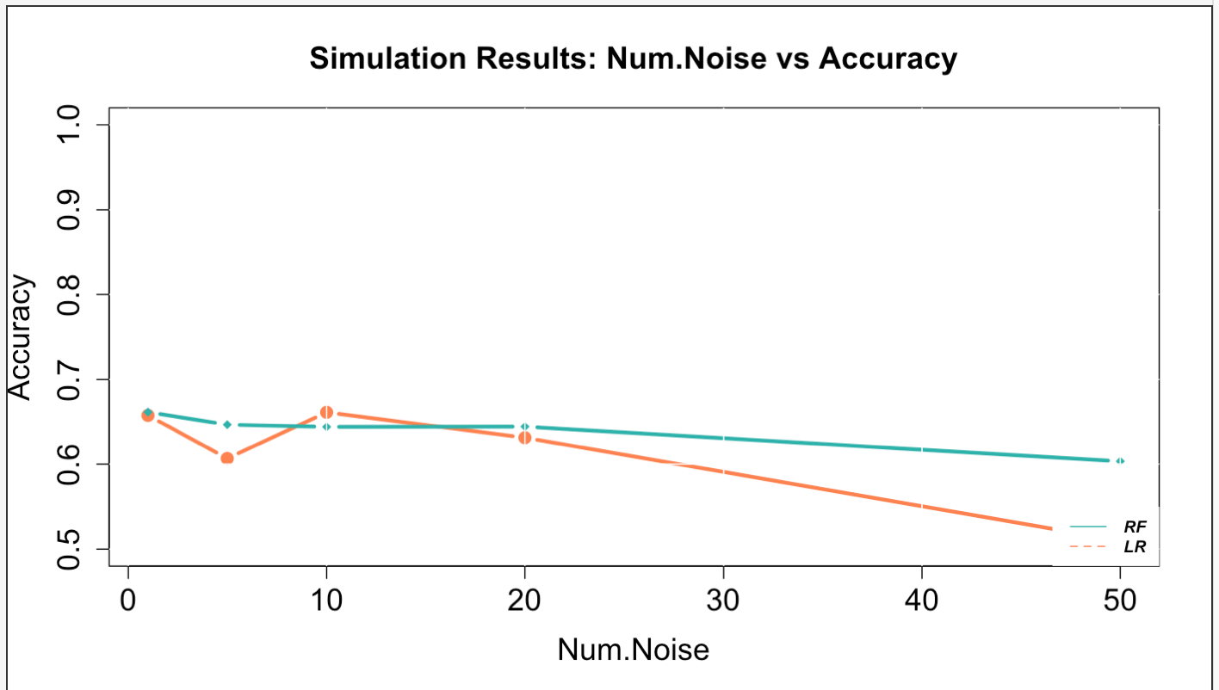
Case 2: 10 Simulations

Slide 17
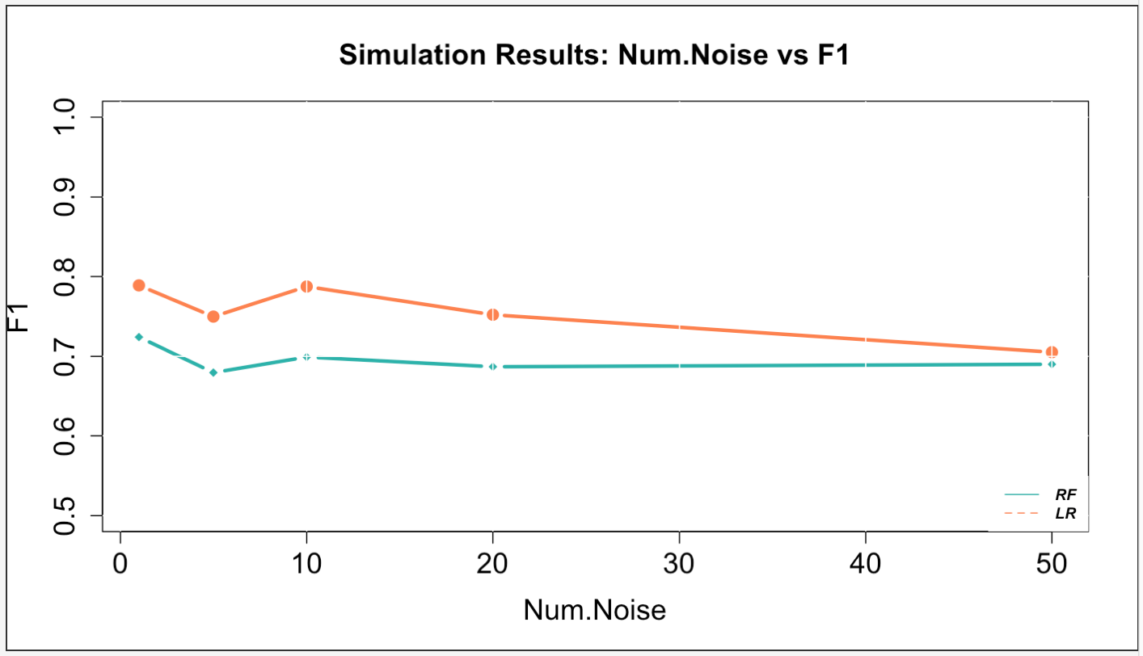
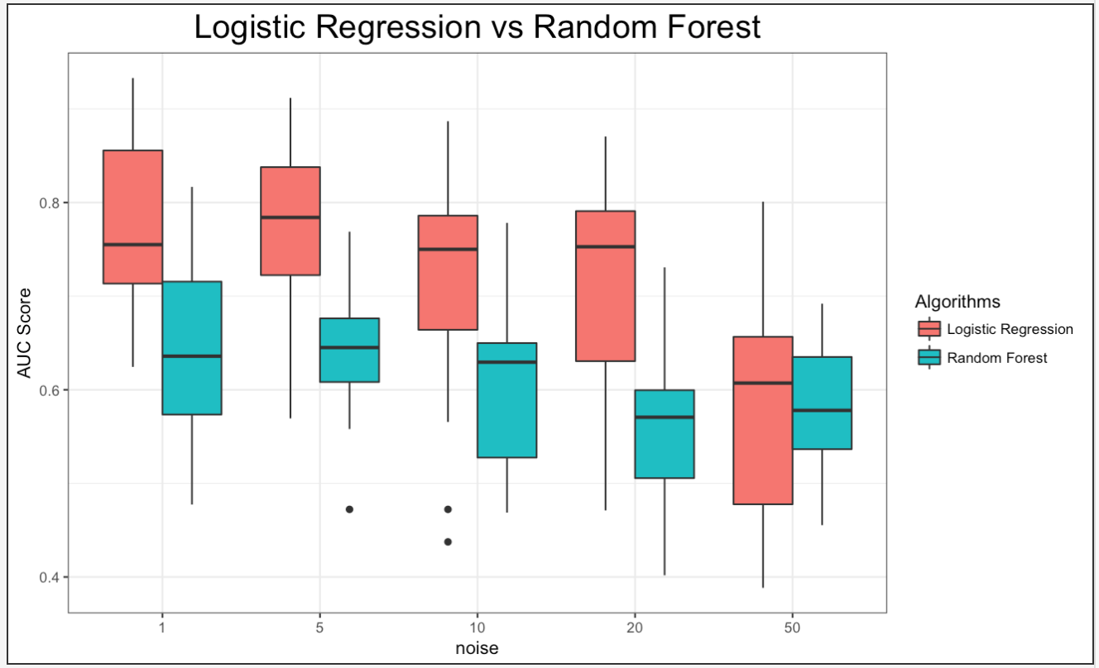
Case 2: 10 Simulations

Slide 18

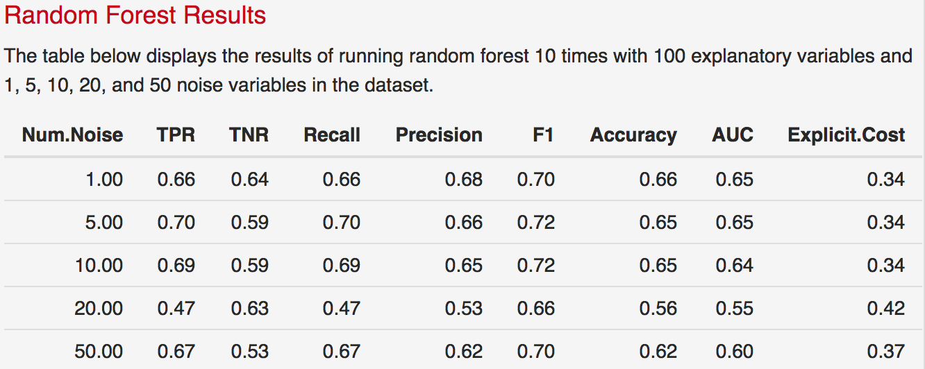
Case 2: 100 Simulations

Slide 19
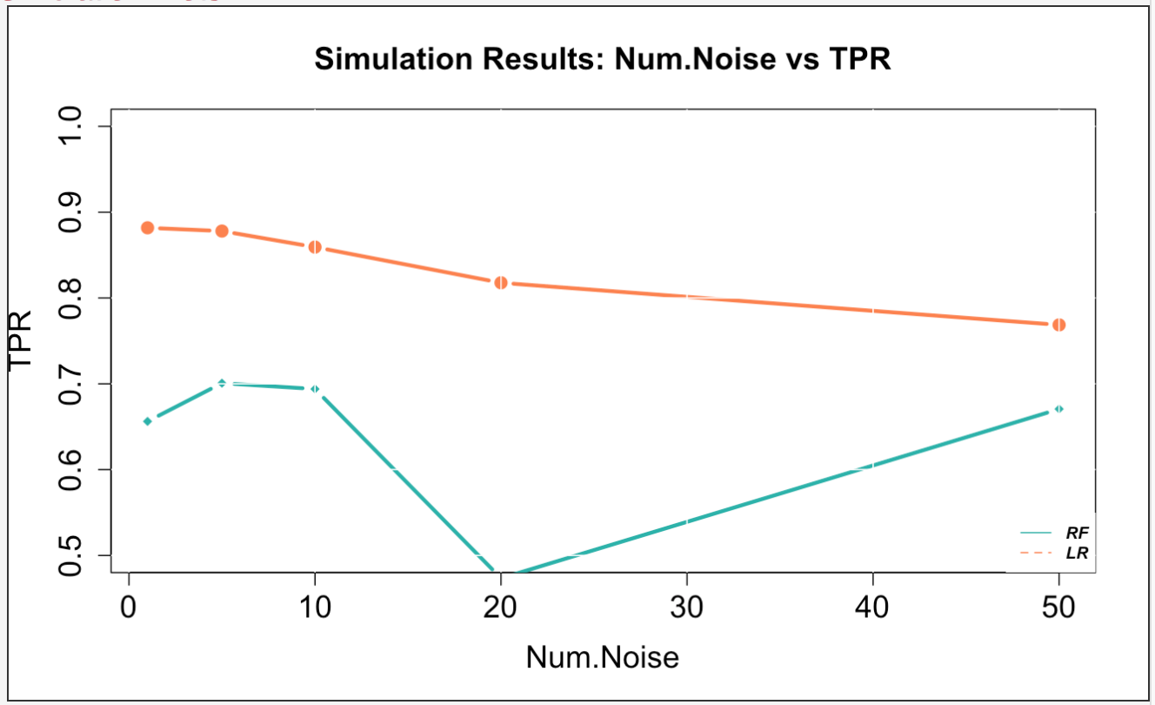
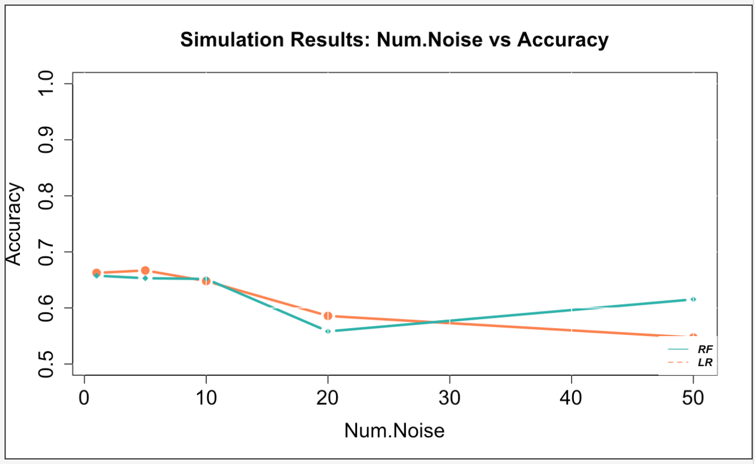
Case 2: 100 Simulations

Slide 20
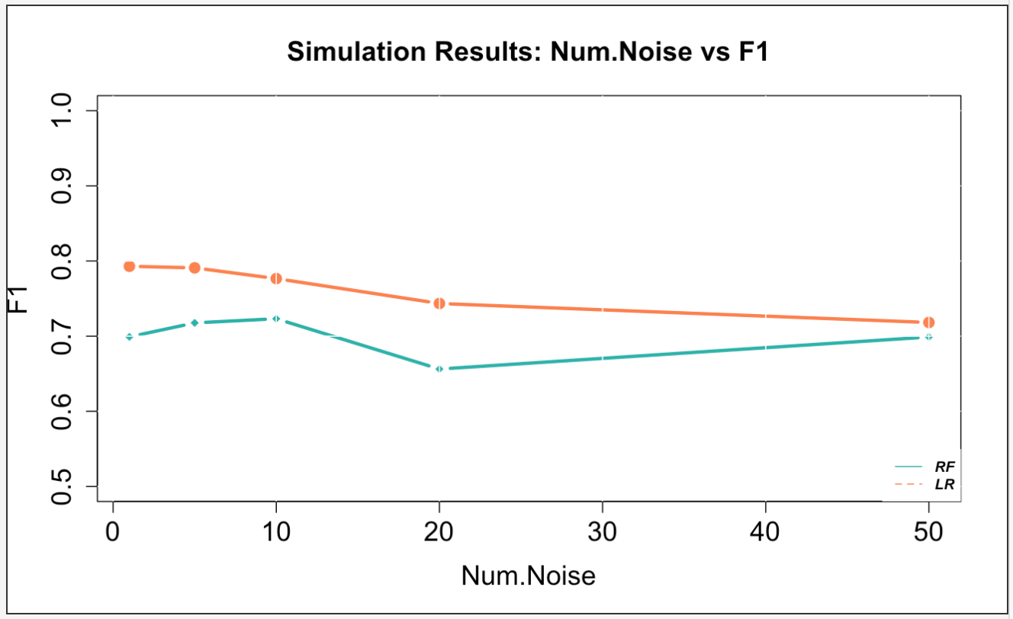
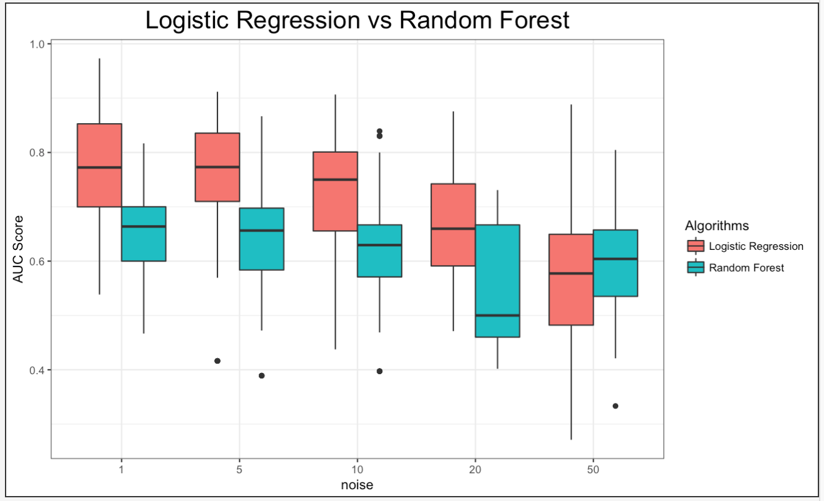
Case 2: 100 Simulations

Slide 21
Case 2: 1,000 Simulations

Slide 22
Case 2: 1,000 Simulations

Slide 23
Case 2: 1,000 Simulations

Slide 24
Case 2: 10,000 simulations

Slide 25
Case 2: 100,000 simulations

